Slide 1

2019 Myotonic Annual Conference
September 13-14, 2019
Philadelphia, PA

Slide 2
Pain management in DM2
Doris G. Leung, MD, PhD
Kennedy Krieger Institute
September 14, 2019

Slide 3
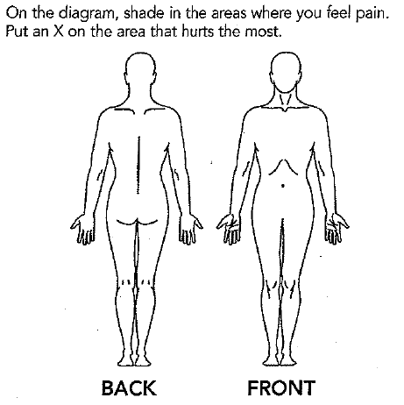
Outline
Understanding musculoskeletal pain
What research has been done in DM2
  Case series
  Survey research
  Observational cohort studies
Treatment modalities for pain

Slide 4
What do we know about pain in DM2?
Pain is extremely common in DM2
  46 to 86% of patients report pain as a symptom of disease
It is often the presenting symptom
  Approximately one third of cases
The quality of the pain is different in DM2 compared to DM1 and other neuromuscular diseases

Slide 5
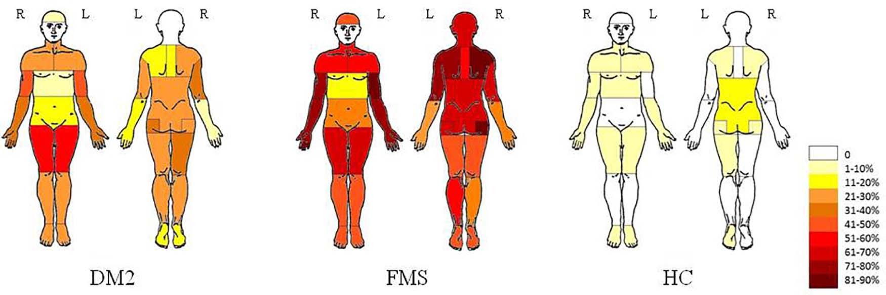
Research on pain in DM2
Distribution
Reduced pain thresholds
van Vliet J. et al., J Pain, 2018

Slide 6
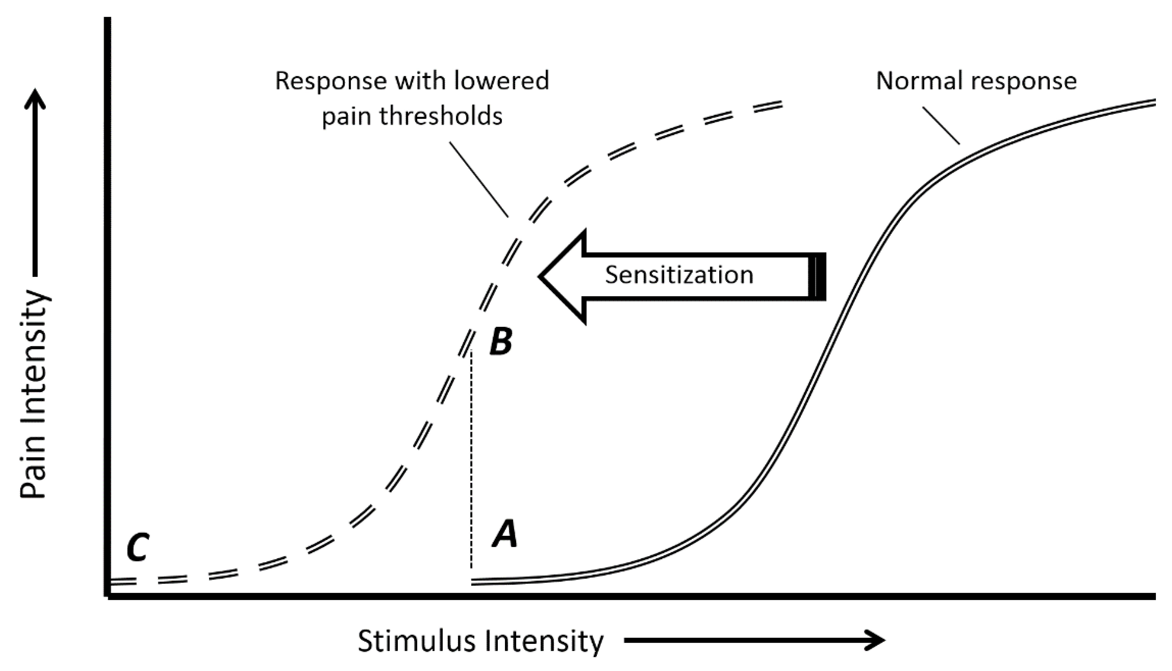
Pain sensitization
After an initial stimulus, pain receptors exhibit a larger response to both painful and non-painful stimuli.
Borstad and Woeste, Braz J Phys Ther, 2015

Slide 7
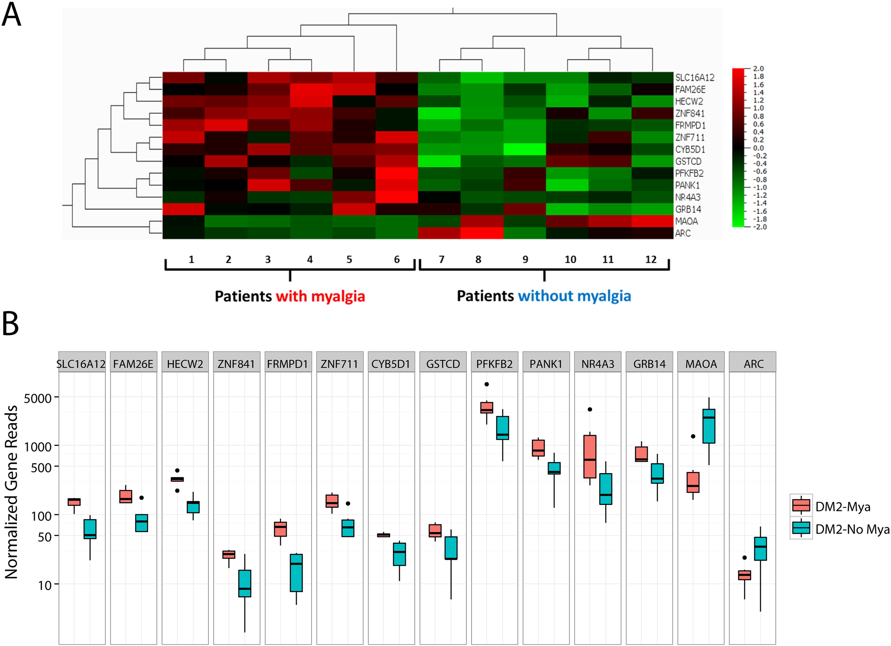
Genetics associated with pain?
RNA sequencing shows that people with DM2 with muscle pain have different gene expression patterns than people with DM2 who do not have muscle pain.
Moshourab et al., EBioMedicine, 2016

Slide 8
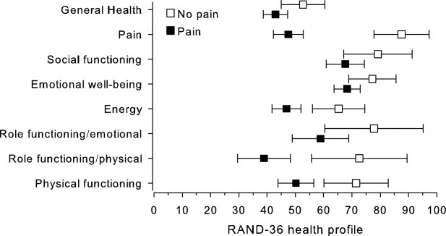
The impact of pain
Physical
Psychological
Social
  Activities
  Financial
Suokas et al., Muscle and Nerve, 2011

Slide 9
An approach to pain management

Slide 10
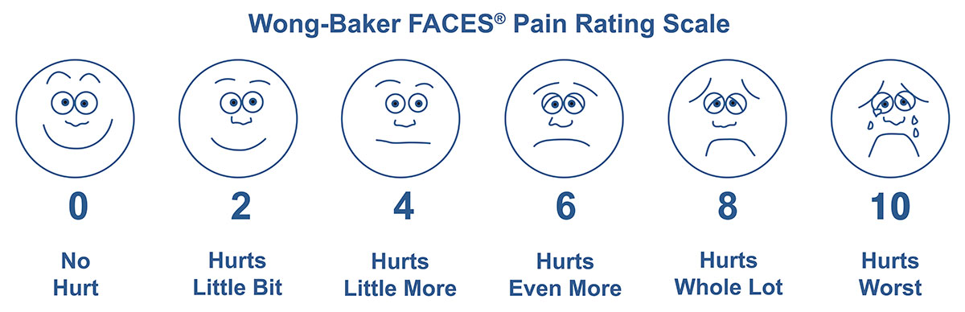
How do physicians assess pain?
Location
Severity
  Pain scales
Quality of the pain

Slide 11
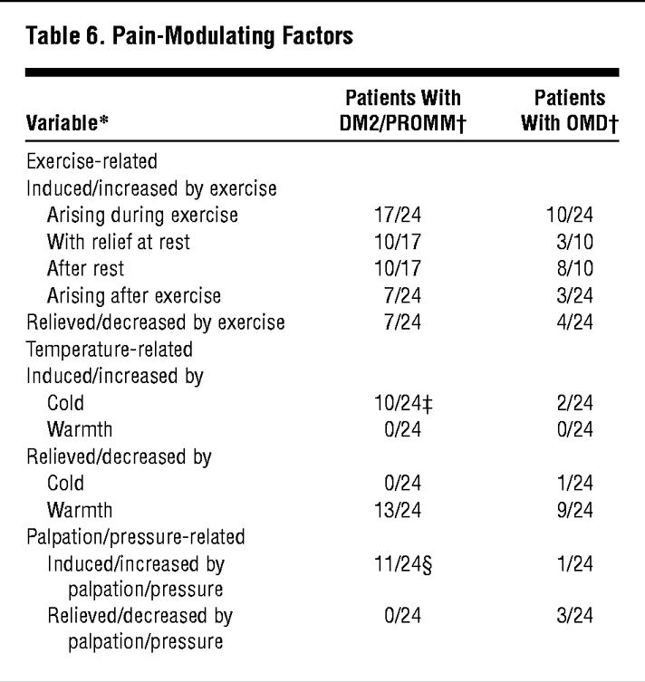
How do physicians assess pain?
Interference with daily activities and function
Aggravating/alleviating factors
  Activities/positions
  What interventions have been tried
Arch Neurol. 2004;61(12):1938-1942. doi:10.1001/archneur.61.12.1938

Slide 12

Concepts in chronic pain management
Recognizing causes and contributors
Setting reasonable goals
Developing treatment plans
  Systematic
  Personalized
  Multidisciplinary

Slide 13
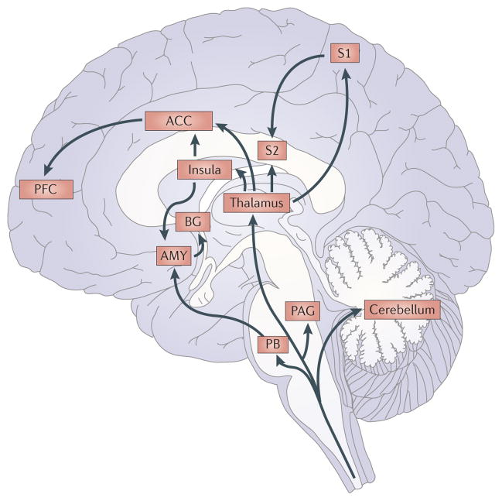
Causes and contributors
Pain management is harder to achieve when other conditions go untreated
  Nutrition
  Endocrine
  Medications
  Sleep
  Mental health
Bushnell et al, Nat Rev Neurosci, 2015

Slide 14

Treatment modalities
Pharmacologic
Interventional and surgical
Physical medicine-based
Hands-on treatment
Cognitive-based

Slide 15
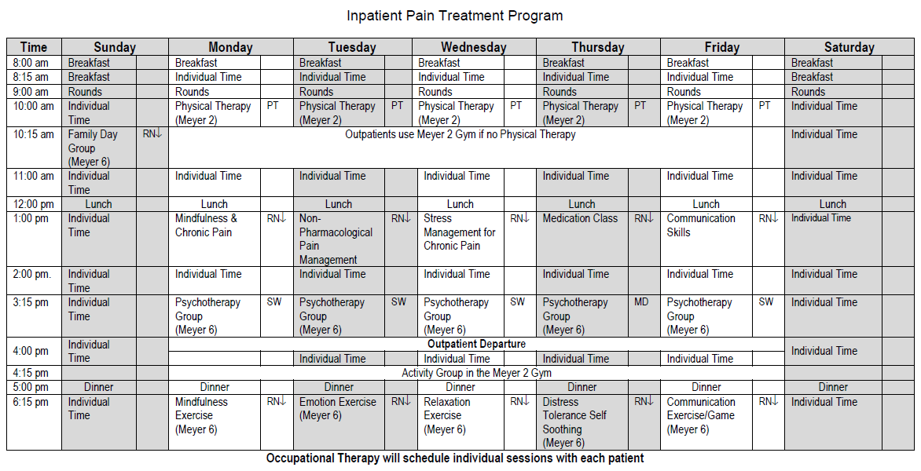

Slide 16
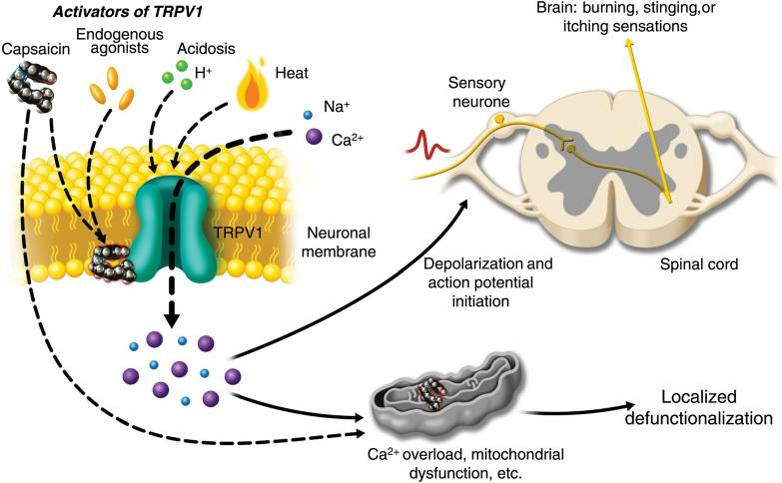
Pharmacologic therapies
Mexiletine
Anti-inflammatory
Topical
  lidocaine
  capsaicin
https://commons.wikimedia.org/wiki/File:Activation_of_TRPV1_by_capsaicin.jpg
Notes:
Activation of TRPV1 by capsaicin results in sensory neuronal depolarization, and can induce local sensitization to activation by heat, acidosis, and endogenous agonists. Topical exposure to capsaicin leads to the sensations of heat, burning, stinging, or itching. High concentrations of capsaicin or repeated applications can produce a persistent local effect on cutaneous nociceptors, which is best described as defunctionalization and constituted by reduced spontaneous activity and a loss of responsiveness to a wide range of sensory stimuli.

Slide 17
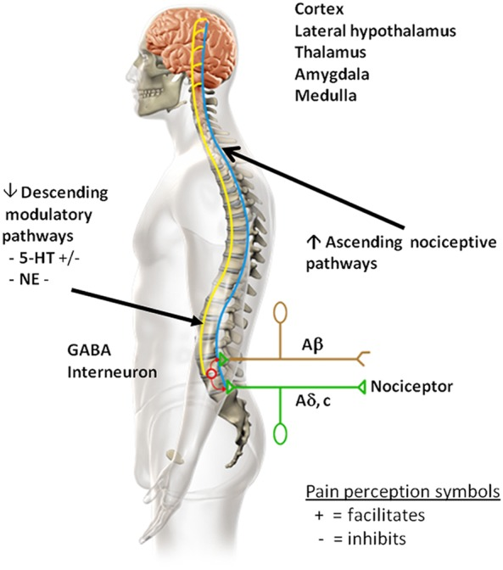
Pharmacologic therapies
Antidepressants
  SNRIs
  Tricyclic antidepressants
Neuroleptics
Muscle relaxants
Brown, JP et al., Ther Adv Musculoskeletal Dis, 2013

Slide 18
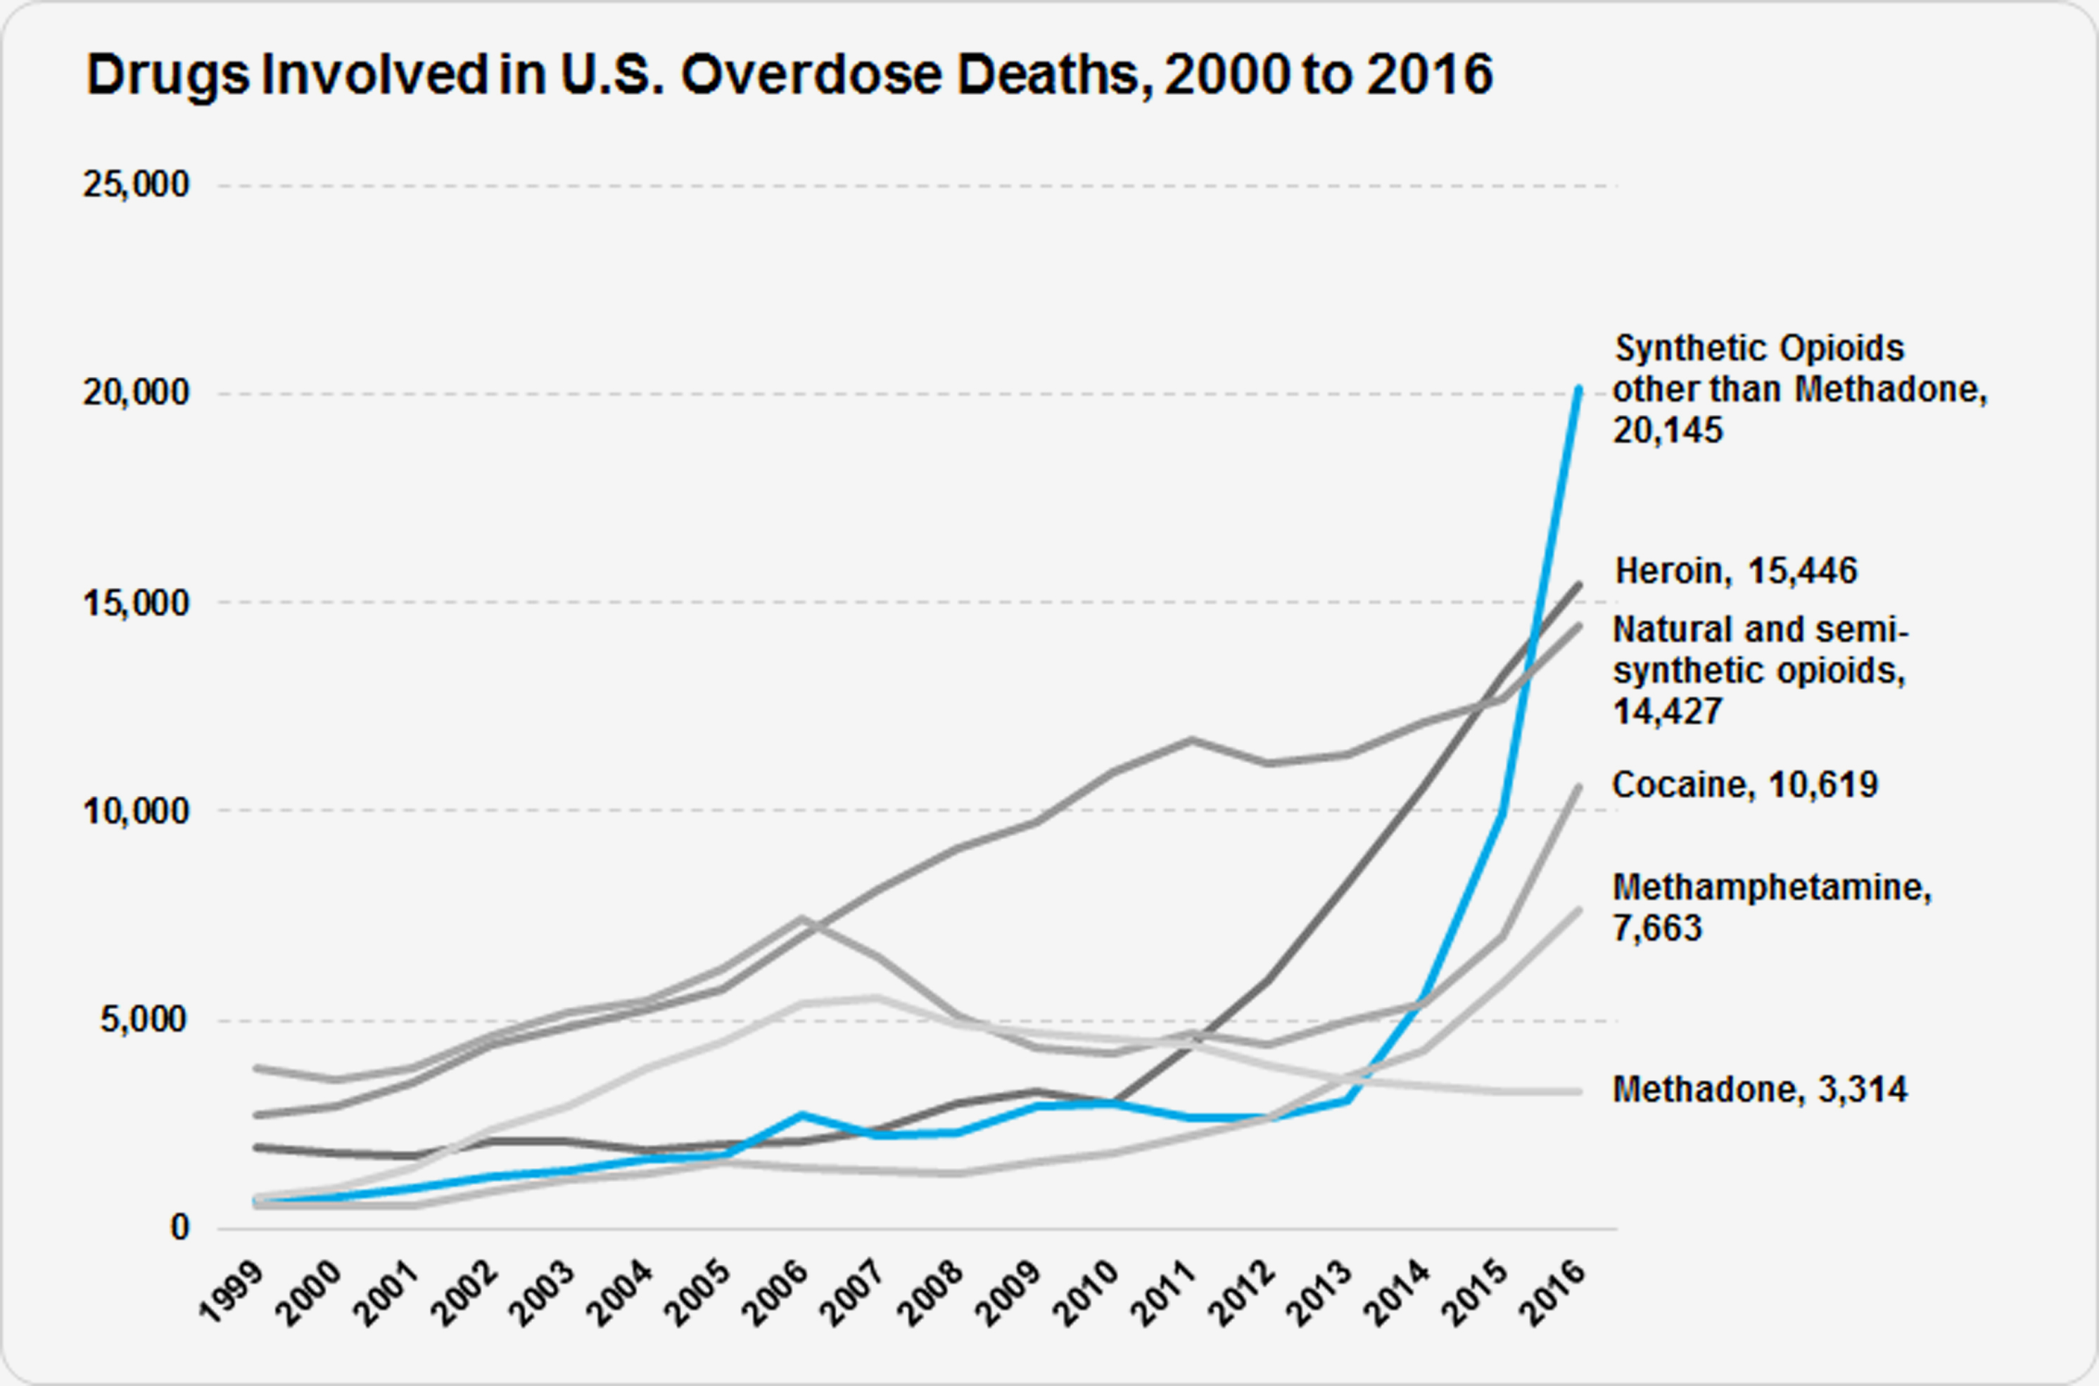
Pharmacologic therapies – opiates
Acute vs. chronic pain
Issues specific to myotonic dystrophy
  Respiratory
  Gastrointestinal
  Cognitive
New prescribing requirements
  Monitoring programs
  Limiting quantities
  Naloxone
nih.gov

Slide 19
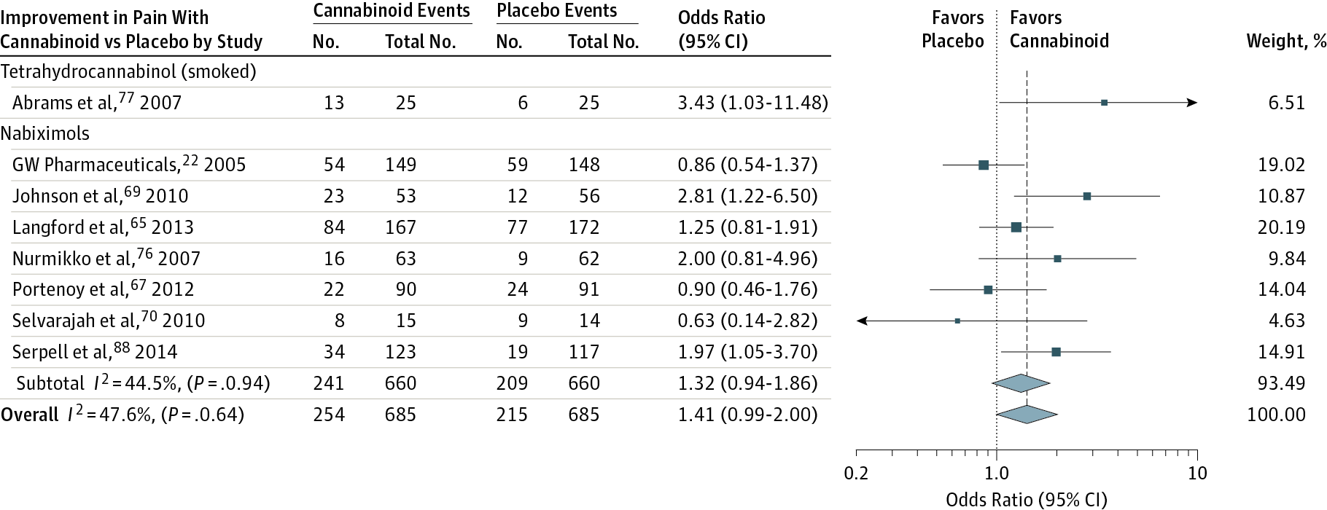
Pharmacologic therapies – cannabinoids
Whiting et al., JAMA, 2015
Notes:
Odds indicate 30% or greater improvement in pain with cannabinoid compared with placebo, stratified according to cannabinoid. The square data markers indicate odds ratios (ORs) from primary studies, with sizes reflecting the statistical weight of the study using random-effects meta-analysis. The horizontal lines indicate 95% CIs. The blue diamond data markers represent the subtotal and overall OR and 95% CI. The vertical dashed line shows the summary effect estimate, the dotted shows the line of no effect (OR = 1).

Slide 20
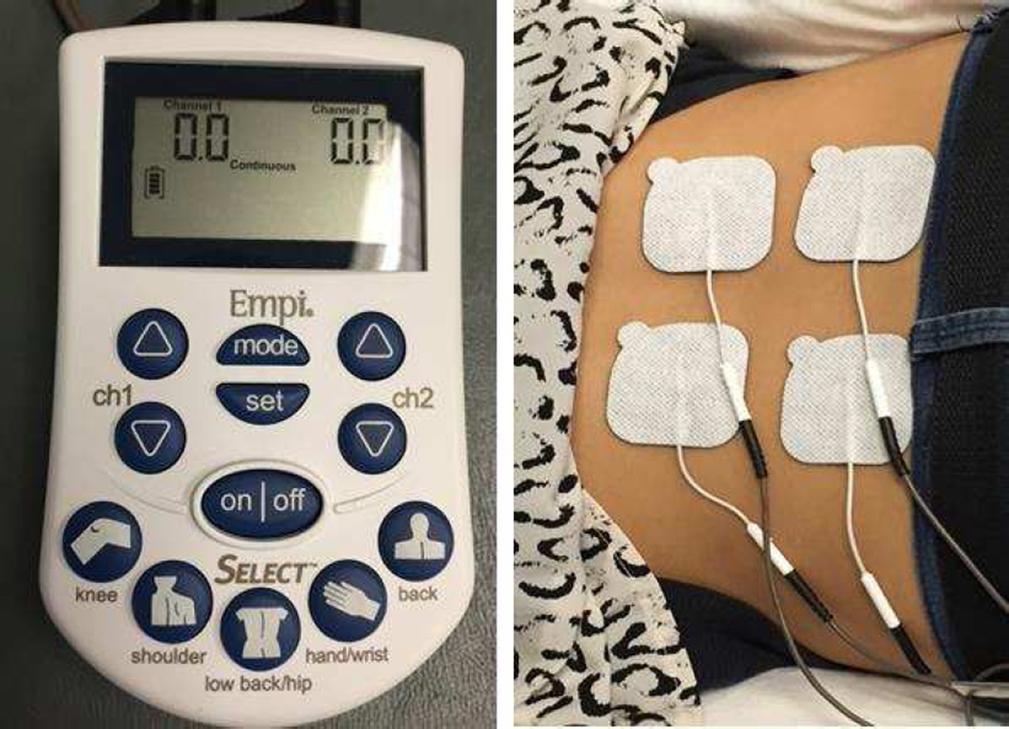
Interventional/surgical
Injections
  Steroids
  Nerve blocks
Nerve ablation or neurolysis
Neuromodulatory
  Transcutaneous Electrical Nerve Stimulation (TENS)
  Heat Therapy/Cold Therapy
  Transcranial magnetic stimulation
  Spinal cord stimulation

Slide 21

Exercise-based treatment
Exercise types
  Stretching
  Core stabilization
  Aerobic
  Resistance
Physical therapy
Aquatic therapy

Slide 22

Hands-on treatment
Chiropractic
Massage
Acupuncture
Other complementary therapies
hopkinsmedicine.org

Slide 23
Cognitive-based treatment
Pain
Thoughts
Feelings
Behavior
Pain psychology
Cognitive behavioral therapy
Distraction
Relaxation techniques
  Biofeedback
  Hypnosis
  Meditation
Bushnell C. et al., Nat Rev Neurosci, 2013

Slide 24
Summary
Pain is a common manifestation of DM2
Multiple types of therapy can be beneficial in treating pain
Treatment should be personalized
Further research into the mechanisms of pain and treatment for pain in DM2 is needed

Slide 25
Thank you!

