Slide 1

Introduction to
Social Security Benefits
Stacy Braverman Cloyd
National Organization of Social Security Claimants’ Representatives (NOSSCR)

Slide 2
What are we going to talk about?
Who I am and what I do
How Social Security determines disability
The benefits application process
Hiring a representative?
Things to consider after getting benefits
Write questions on cards, and MDF will share Question time (keep it general, please!)

Slide 3

A little about NOSSCR
National Organization of Social Security Claimants’ Representatives
Founded in 1979
Our members: attorneys and non-attorneys in nonprofits and private firms
Educational materials and conferences
Represents representatives to SSA, Congress, the public, and more
What I did before NOSSCR

Slide 4


And now….Social Security!

Slide 5

SSI and SSDI are Different
But they have the same definition of disability.

Slide 6
How does SSA define “disability”?
1. Are you doing “substantial gainful activity”?
2. Do you have a severe impairment that has lasted/is expected to last more than 12 months or is expected to result in death?
4. Can you return to past relevant work (if any)?
5. Can you do other types of substantial gainful activity?
3. Do you meet/equal a listing?
If not,
Note: kids have a different definition

Slide 7
Steps 1 and 2
Substantial Gainful Activity
  $1130 a month in 2016 ($1820 if blind)
  More complicated than the amount on paycheck: subsidy, unearned income (accrued leave), UWAs
Severe impairment
  More than minimal limitation in activities of daily living
  Lasting 12 months or more, or expected to be fatal
  Combination of impairments
  Side effects of treatment also count

Slide 8
Step 3: What is a Listing?
A definition of an impairment so severe that if you meet or equal it and have passed the first two steps in the sequential evaluation process, you qualify for disability benefits.
They’re in 20 CFR Part 404, Subpart P, Appendix 1 https://www.ssa.gov/disability/professionals/bluebook/AdultListings.htm
Kids have their own listings

Slide 9
Step 3: Some Listings of Interest
Skeletal muscle problems: 1.00 (musculoskeletal)
Heart abnormalities: 4.00 (cardiovascular)
Breathing difficulties: 3.00 (respiratory)
Cataracts: 2.02, 2.03, 2.04 (vision)
Issues with speech and swallowing: 2.09 (loss of speech), 5.08 (weight loss: BMI under 17.5), 5.06 (maybe = IBD?)
Cognitive impairment: 12.05 (ID), 12.02 (organic brain dysfunction)
Diabetic symptoms: 9.00 explains that other listings are used
Symptoms from myotonic.org

Slide 10
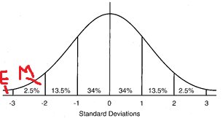
Steps 4 and 5
For adults who got through steps 1 and 2, but didn’t meet a listing, the decisionmaker determines Residual Functional Capacity and uses it to answer two questions:
Can the claimant go back to past relevant work?
  Within past 15 years, at SGA level, done long enough to learn how
If not, is there other work this individual can do?
  “Grids” using RFC, age, education, and work experience
  If not found disabled using grids, other exertional and non-extertional limitations are considered
For kids, the decisionmaker uses “domains”
  one extreme or two marked limitations.

Slide 11
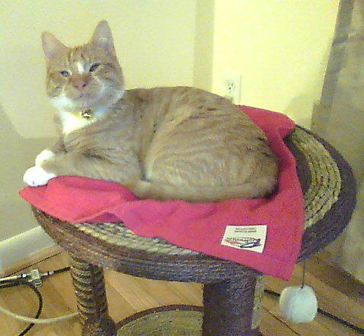
Kind of complicated, right? Here, take a break and enjoy this picture of my cat.
If you have questions, now is a good time to write them down.
Now let’s talk about how people apply for Social Security disability benefits.

Slide 12
Initial and Reconsideration Stages
Decisions can take several months
Several ways for SSDI, only in person for SSI
Often a good idea to apply for SSI and SSDI
Claimants and representatives can use this time to submit medical records and other evidence
SSA contracts with state agencies to make decisions at these stages
About 2/3 get denied at these stages
This doesn’t always mean they have bad cases
60 (+5) days to appeal but good cause extensions
Online or paper appeals allowed
10 states don’t have reconsideration: AL, AK, CA (parts of LA only), CO, LA, MI, MO, NH, NY, PA
Recon
Hearing
Appeals Council
Federal Court
Not yet applied
Initial

Slide 13
Hearings
Online hearing requests are possible in most cases
Average 579 days from hearing request to decision
Critical case “flag” available for TERI, 100% VA rating, wounded warrior, potentially violent, dire need
Video hearings but allowed to opt-out
First time you may get to talk to a decisionmaker
Nonadversarial hearings, last about 20-90 minutes
Who’s there: Administrative Law Judge, medical and/or vocational expert, hearing recorder
Rare to get a decision at the hearing
In 2015, 45% allowed, 18% dismissed, 37% denied
Recon
Hearing
Appeals Council
Federal Court
Not yet applied
Initial

Slide 14
Appeals Council and Beyond
Takes years
Often must decide between Appeals Council and new application; possible to reapply while in federal court
In 2015, 1% allowed and 13% remanded by Appeals Council
2% allowed and 45% remanded by federal court
Recon
Hearing
Appeals Council
Federal Court
Not yet applied
Initial

Slide 15
Should I Get a Representative?
NOSSCR lawyer referral service: 1-800-431-2804
Representatives can help collect medical records and other evidence, write briefs and motions, question you and experts, counsel you after decision
Lawyer or nonlawyer?
Fees: in most cases, 25% of back benefits up to a limit of $6000, but it’s important to understand the agreement for your case
Pick someone who makes you feel comfortable

Slide 16
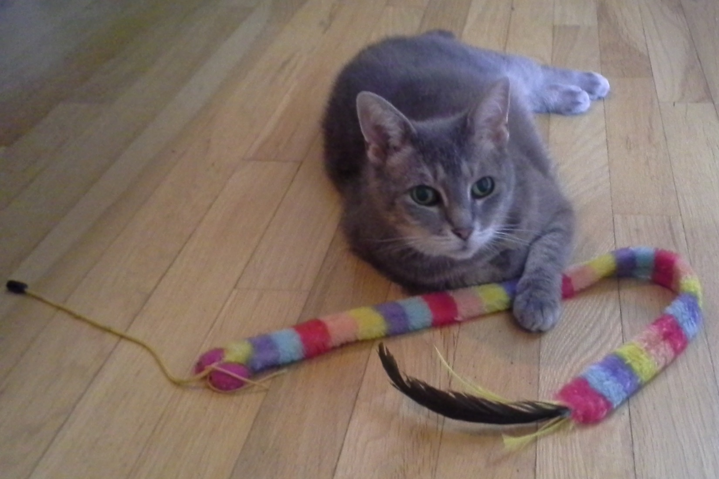
More questions? Write them down now.

Slide 17


Post-Eligibility Issues
You got benefits! Great!
But you’ve still got stuff to think about.
  What does SSA need to know?
  Who will manage your money?
  How should you save or spend?
  Do you owe taxes on benefits?

Slide 18
What is an Overpayment?
Someone received more benefits than SSA now thinks s/he was eligible for
Common causes:
  Work (SSI and SSDI handle it differently)
  Excess assets/unearned income/ISM in SSI cases
  Being out of the US for more than 30 consecutive days
  Extended hospitalization (not always cause for benefit cut)
  Period of incarceration/ fleeing felon
  Disability cessation
  Change in marital status (deeming income from wife to husband or parent to child)

Slide 19

Overpayment Options
Pay it
  SSI recoupment: 10% of maximum benefit ($73)
  $10/month repayment allowed if requested by full LIS, TANF, etc. recipient: http://policy.ssa.gov/poms.nsf/lnx/0202210030
Appeal
  Request reconsideration of the amount or existence of the overpayment
  Follow deadlines to keep benefits pending and preserve appeal rights.
Request Waiver of the Overpayment
  The overpayment does exist, but
    It’s not the beneficiary’s fault, and
    The beneficiary can’t afford to repay the overpayment the way SSA wants.
    Admin waiver for OPs $1000 or less, unless “indication of fault”

Slide 20
You Did It!

